Slide 1
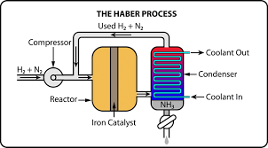

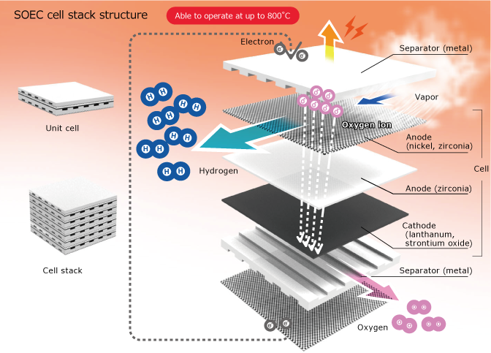
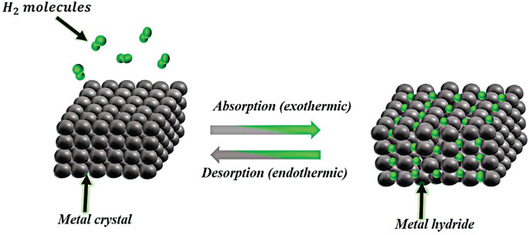

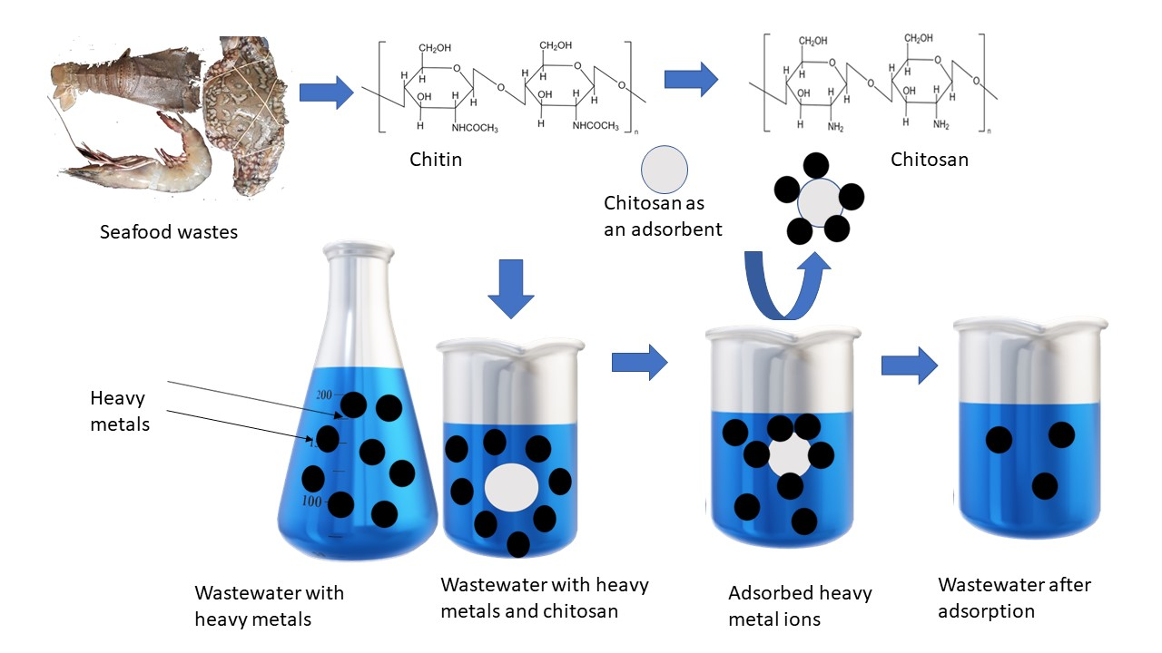
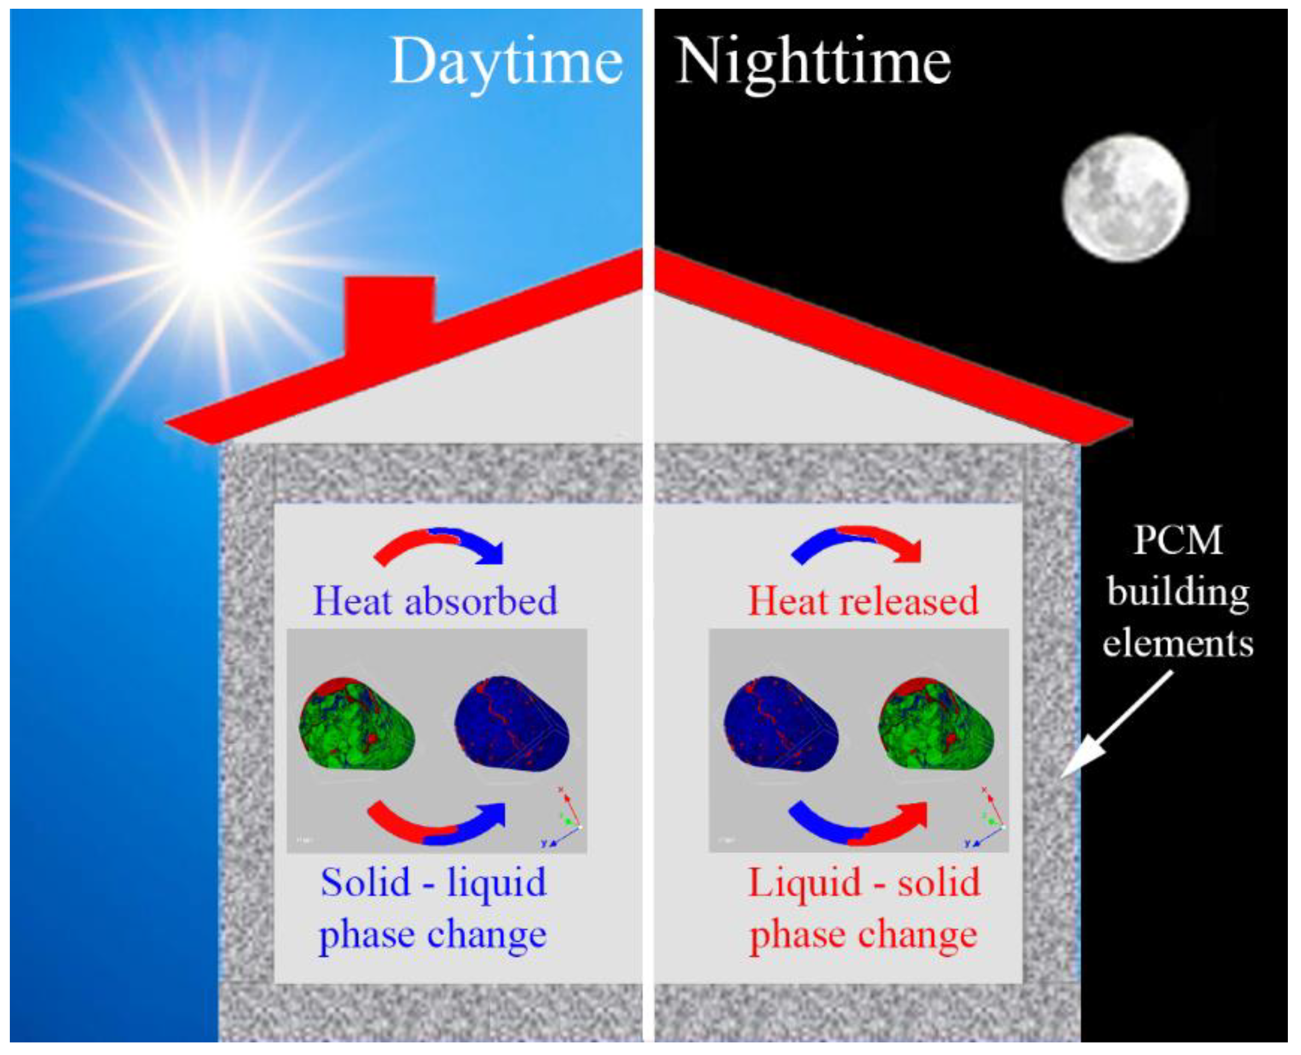
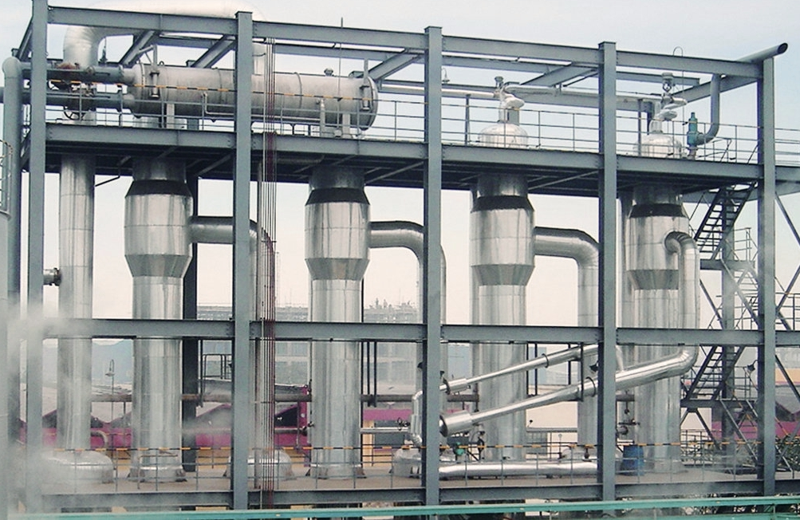
Integrating TES with Hydrogen storage in Metal Hydrides
_{SOEC}
Solid oxide electrolyzer
Heat recovery
Electricity
H₂
Metal hydrides
H₂
ketoson
Clean water
_{MEE}
_{Heat desorption}
Multi-stage flash evaporation
_{Heat Absorption}
Thermal energy storage
_{Continuous flow}
_{Chitosan treatment}

